Slide 1
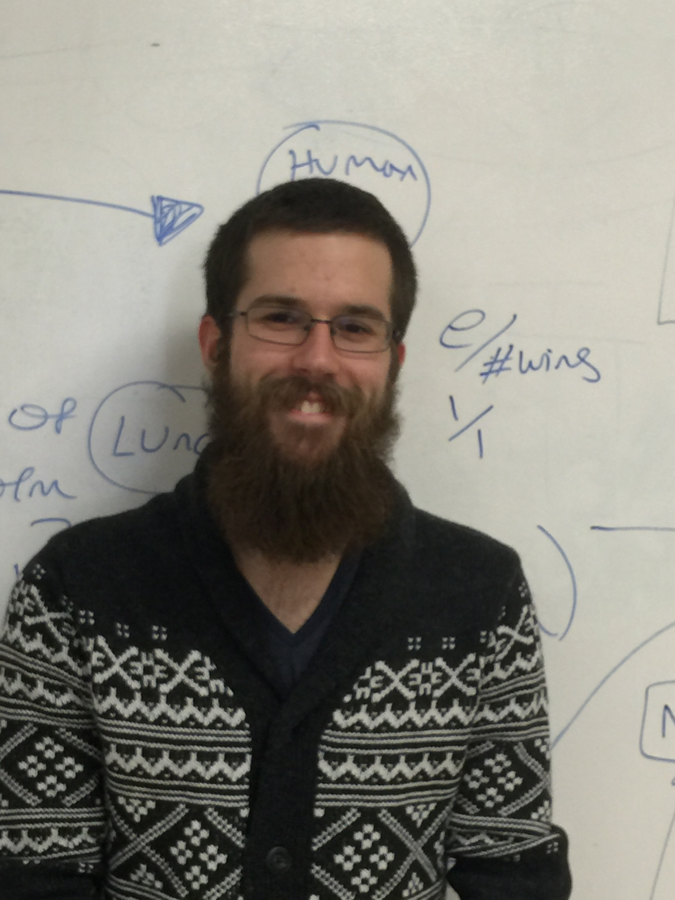
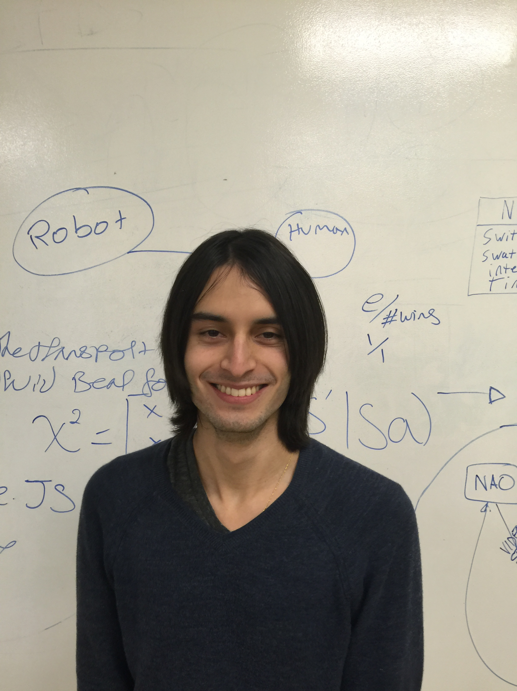
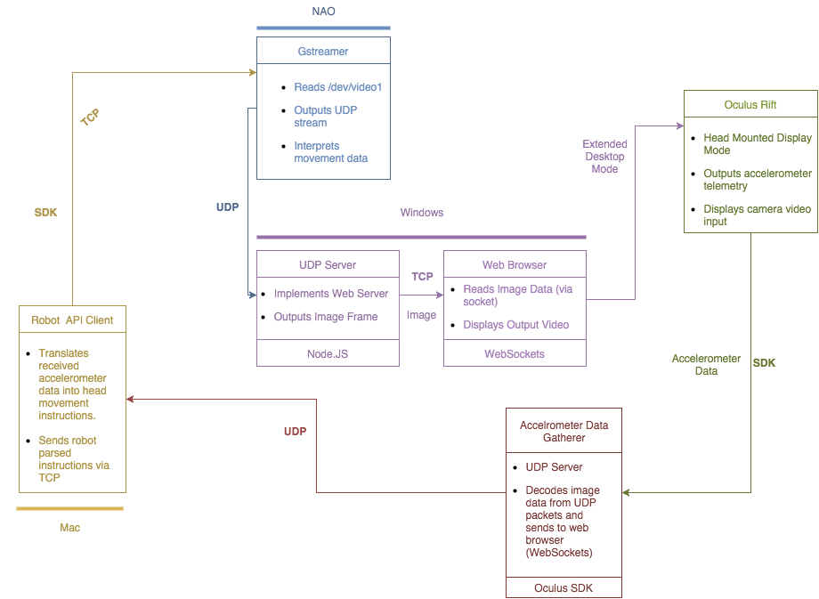
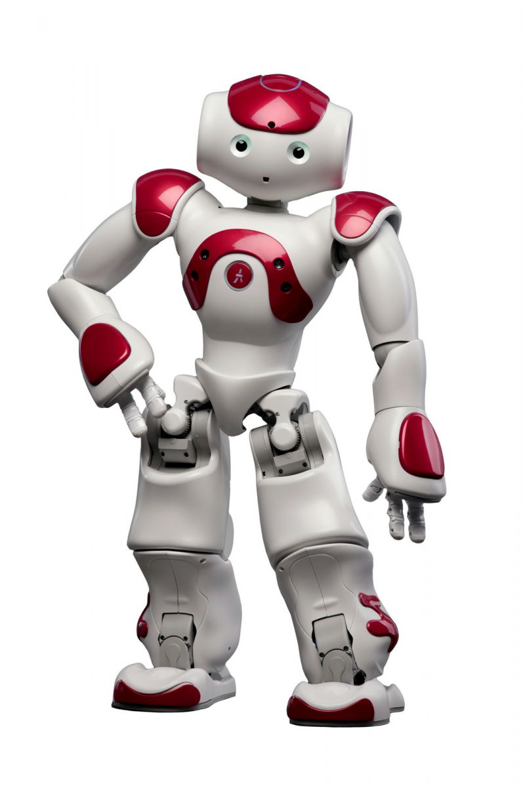
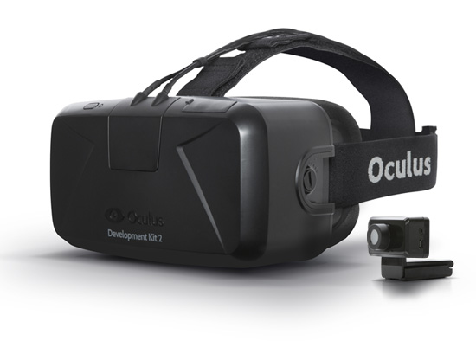
Human-robot interfacing: Using NAO and Oculus Rift for video feedback and control
Objective
Our goal is to control a NAO robot’s head movement with an Oculus Rift while simultaneously displaying the robot’s vision onto the oculus rift.
We propose a general design for controlling a robot remotely using digital sensory data
Our contribution is a model in which networked communication achieves remote movement with a machine
Technology Used
Presenters
John Wesley Hayhurst johnwesley.hayhurst.12@cnu.edu
Juan Vallejo
juan.Vallejo.12@cnu.edu
C++
NAO SDK
Oculus SDK
Node JS
Gstreamer
UDP
TCP
Design
John Wesley Hayhurst
Juan
Vallejo
johnwesley.hayhurst.12@cnu.edu
juan.vallejo.12@cnu.edu
Meet The Components
NAO Robot:
Aldebaran’s NAO robot is a powerful robot capable of a wide range of human interfacing options. This was a great starting point for this project because of the extensive SDK for controlling the robot’s movements.
Oculus Rift:
One of the top Headsets in VR technology with an extensive range of applications and help. This VR headset was a no brainer for developing the technology to interface with the NAO robot.
Capstone Presentation • December 4th 2015 • Christopher Newport University

